Slide 1
NBA Rising Stars : Rising Stars Time Leap

Slide 2

First, Some Context
▶ One of NBA fans and analyst’s favorite pass times is to compare younger rising stars to respected hall of fame players. Most of these comparisons come from the ‘eye test’ watching players styles.
▶ Many players also get compared to players via statistics, mostly on the career level. While these cumulative numbers do give some insights, there is another layer to this problem that can explored with machine learning.

Slide 3
So What Question Needs to Be Answered
Are the current NBA rising stars going to hold the same Hall of Fame comparisons five years from now?

Slide 4
▶ NBA API
▶ This web api has 28 different endpoints. 2 Static and 26 Dynamic endpoints. This endpoint contains in depth defensive stats, which other sources do not hold. The API scraps from the nbastats website.
▶ Basketball Reference
▶ Scraping the basketballreference website will be simple since all of the data is stored tabular. This is a great resource for wrangling seasonal data of primary stats
▶ Sports Data io
▶ Sports Data io has data sets that relate to the sports betting side of basketball. However, also included is data referring to player vs. team trends and starting lineups
Data Sources
There are multiple sources of data that can be useful for retrieving NBA stats, spanning
Possessions Games Seasons Careers

Slide 5
Project Methodology (Original)
Web Scraping
NBA Rising Stars
Data Collection
Data
Formatting
Data Exploration
Web API
Provide Insights
Cluster Analysis
K-Means Clustering
NBA Advanced Stats
Arima
Evaluation
GBM
Time Series
Random Forest

Slide 6
Project Methodology (New)
Web Scraping
NBA Rising Stars
Data Collection
Data
Formatting
Data Exploration
Web API
Provide Insights
Cluster Analysis
K-Means Clustering
NBA Advanced Stats
Tableau Dashboard
Evaluation
AutoReg
Time Series

Slide 7
Project Milestone Path (Original)
NBA API
Basketball Reference
Sports Data io
Adv Metrics
Clustering
Time Series
Analysis
Season
Position Distribution
How will I Aggregate the Data?
Declining based on age
Declining based on similar career path
Players entering
their primes
Injuries
Filter: First 5 Cont.
Seasons
Hall of Fame
Career
Season
1. Offense
Position
Retirement
Pts Reb Ast Stl Blks TO’s
Pos Usage FG%
FLs FT’s ASG
Age
2. Defense
Off Rat Def Rat FG%
Title’s Awards Win Shares Usage Clutch (4Q) Stats
PG SG
SF PF
C
Confidence
Trade Block
3. Win Shares
If Pos
Switch
Re-Cluster
Late Bloomers
Most Played

Slide 8
Project Milestone Path (New)
NBA API
Basketball Reference
Sports Data io
Adv Metrics
Clustering
Time Series
Analysis
Season
Hall of Fame
Position Distribution
How will I Aggregate the Data?
Declining based on age
Declining based on similar career path
Players entering
their primes
Filter: First 5 Cont.
Seasons
Retirement
Career
Season
Visualize
The Changes
1. Offense
Position
Off Rat Def Rat FG%
Title’s Awards Win Shares Usage Clutch (4Q) Stats
Pts Reb Ast Stl Blks TO’s
Pos FG%
Age
2. Defense
PG SG
SF PF
C
Confidence
3. Win Shares
If Pos
Switch
Re-Cluster
Late Bloomers
Most Played
Adv Stats

Slide 9
Weekly Milestones & Distribution of Work
Week 1-3 : Data Scraping and Wrangling (3 Data Sources)
Week 4-5 : Formatting and Cleaning Data (Assessing Late Bloomers)
Week 5-6 : Clustering Players & Training AutoReg Model (As Well as Recluster)
Week 7 : Create Tableau Dashboard for Visualizing Time Leap Changes
Week 8 : Prepare Final Project Documentation and Video
Data Wrangling
30%
Data Cleaning
10%
K-Means
15%
Auto Reg
25%
Tableau
10%
Documentation
10%

Slide 10
Results
Validating the K-Means Clustering
The tricky part of K-Means clustering is to find how many clusters is suitable for each set. In our case, one set number of clusters does not apply for every position in the NBA. Some positions may have more variance than others.
In order to validate the number of clusters, I used the elbow method to run K-Means model on each set with 2 clusters all the way up to 11. Each amount of clusters results in a sum of square error (SSE); plotting the number of clusters against the SSE allows the user to see an ‘elbow point’ signifying the most effective number of clusters.
I used the kneed python module to find the elbow point for each position, the module implements the kneedle algorithm into python. Given a set of x and y values kneeds knee locator with return the knee point of the function.

Slide 11

Results
Validating the AutoRegression Model
In order to validate the autoregression model, there needs to be an explanation as to why the project went from ensemble learning to using one time series model prediction. Similar to a few studies I read when getting frustrated; ensemble learning is not always the answer. I can’t explain why it made my error larger and I can’t explain why the computing performance degraded at an exponential rate.
So, since the idea of ensemble learning not being used can be validated, one of the selected linear prediction models needs to be chosen, in order to do this, I validated each model using Root Mean Squared Logarithmic Error (RMSLE). I used this error because I suspected large deviations due to the training data points being so few.
The RMSLE error sat around 7-10% consistently for each player which was the best performance of the original three choices. I had 1 lag for the model and my results were very promising, with a few anomalies of players having high variance between seasons having unusable predictions.

Slide 12
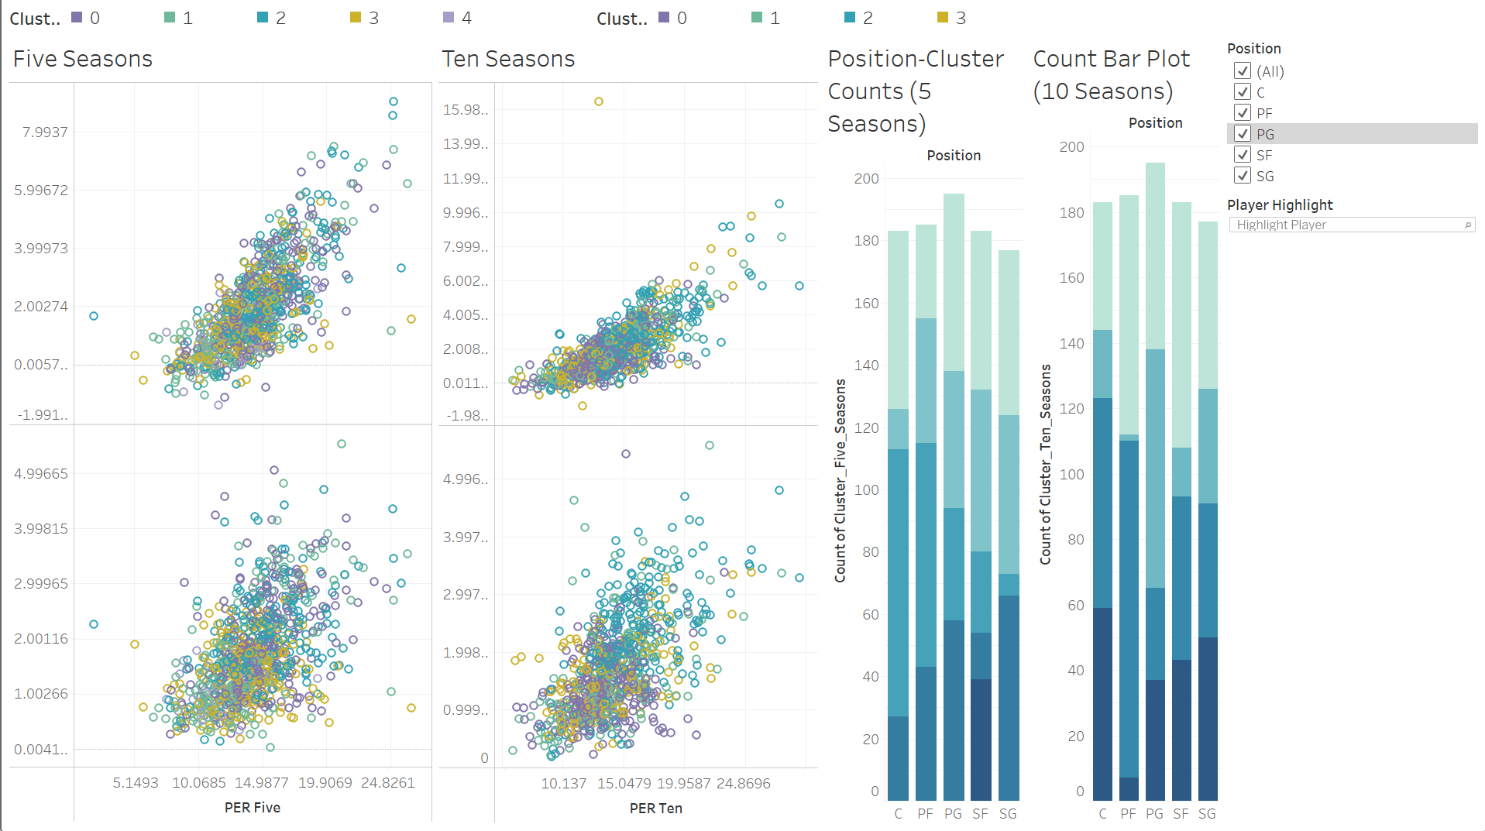
Results
How can I use the data?
This is the sort of project that needs to be visualized for people to understand the significance. NBA analysts predict the futures of young stars based off of speculation and comparisons to players with similar starts to their careers. So to be as entertaining the data will be put into a tableau dashboard with interactive filters for fans to enjoy.

Slide 13
Thank You All!
It’s been an honor to go through this program with such great students and such great professors. I am happy to leave the program producing something that I know the demographic will have fun with and be able to create insights for themselves. Congrats all!
Timothy Miglin
MSDS Student at Regis Univeristy Email : tmiglin@regis.edu

